Slide 1
Unit 6 Parallel Circuits
Part B: Laws and Rules Governing Parallel Circuits

Slide 2
What will you learn?
What a circuit branch is.
Calculate equivalent resistance of a parallel connection.
Apply Kirchhoff’s Current Law (KCL) and Current Divider Rule (CDR) for circuit calculations.

Slide 3
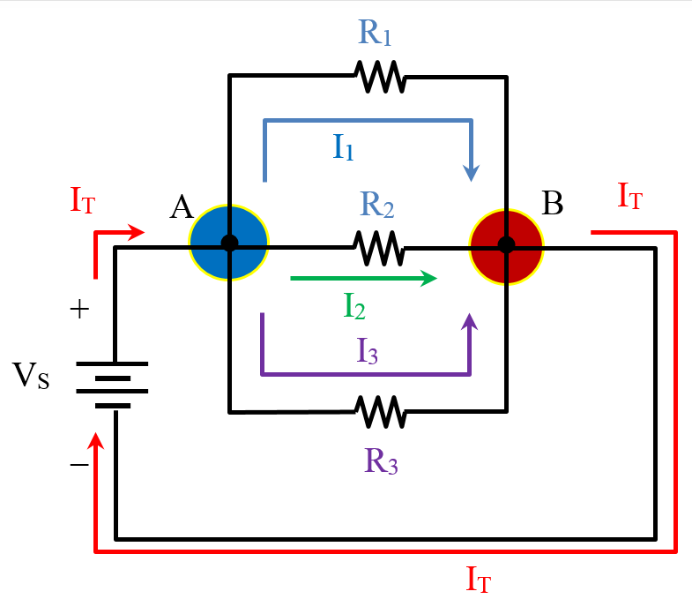
What is a branch in a circuit?
In a given electrical circuit, there are nodes where two or more currents meet.
The circuit here shows these nodes at A and B.
There are currents entering a node, and there are currents leaving that same node.
At node A, current I_{T} enters the node. All other currents (I₁, I₂ and I₃) leave the node.
What would you think of the directions of current flows at node B?

Slide 4
What is a branch in a circuit?
Each parallel path in a parallel connection is called a branch.
The current flowing through a branch is a branch current.

Slide 5

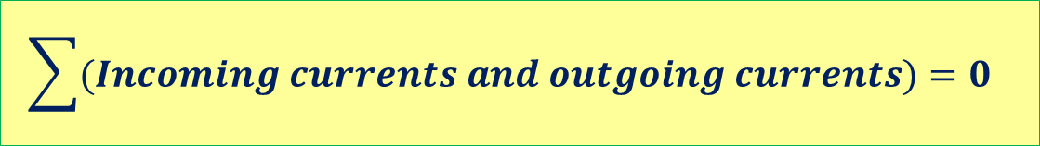
Kirchhoff’s Current Law (KCL)
Kirchhoff’s Current Law states that
The algebraic sum of all the currents at a node is zero.
$$\sum{(Incoming currents and outgoing currents)}=0$$
That is, if an incoming current is considered positive, and an outgoing current is negative, then at node A,
$$I_{T}+{(−I}_{1})+{(−I}_{2})+\left(−I_{3}\right)=0$$

Slide 6
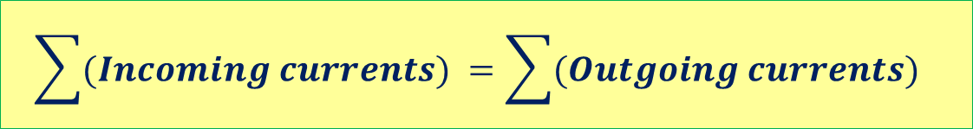

Kirchhoff’s Current Law (KCL)
Rearranging the equation yields
Alternatively KCL states that
the sum of incoming currents equals the sum of outgoing currents.
$$I_{T}=I_{1}+I_{2}+I_{3}$$
$$\sum{(Incoming currents)} =\sum{(Outgoing currents)}$$

Slide 7
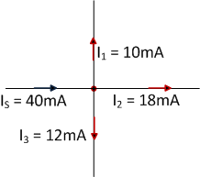

Kirchhoff’s Current Law (KCL)
As an illustration, at node A
Incoming current = I_{S} = 40 mA
Outgoing currents = I₁ + I₂ + I₃ = 40 mA
$${∴I}_{S} =I_{1}+I_{2}+I_{3}$$
Node A
Outgoing currents
Incoming current

Slide 8
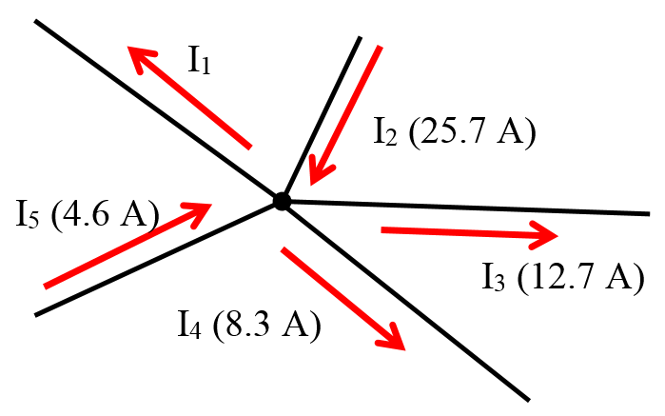
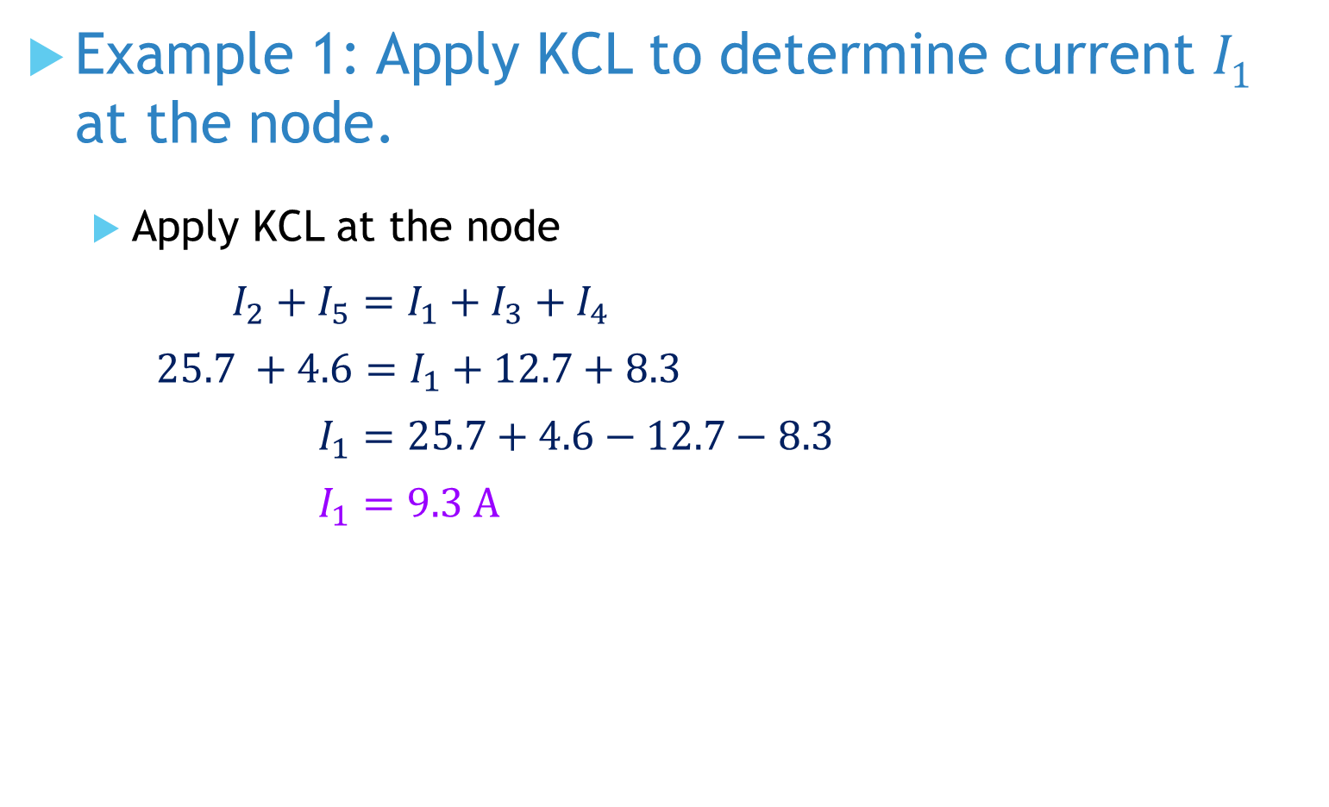
Example 1: Apply KCL to determine current I₁ at the node.
Apply KCL at the node
$${ I}_{2} + I_{5}=I_{1}+I_{3}+I_{4}$$
$$25.7 +4.6=I_{1}+12.7+8.3$$
$$I_{1}=25.7+4.6−12.7−8.3$$
$$I_{1}=9.3 A$$

Slide 9
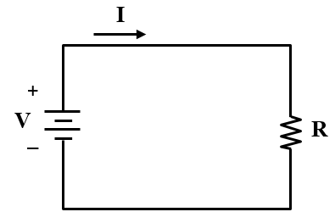

Equivalent Resistance in parallel Connection
By Ohm’s law
$$I=\frac{V}{R}$$

Slide 10
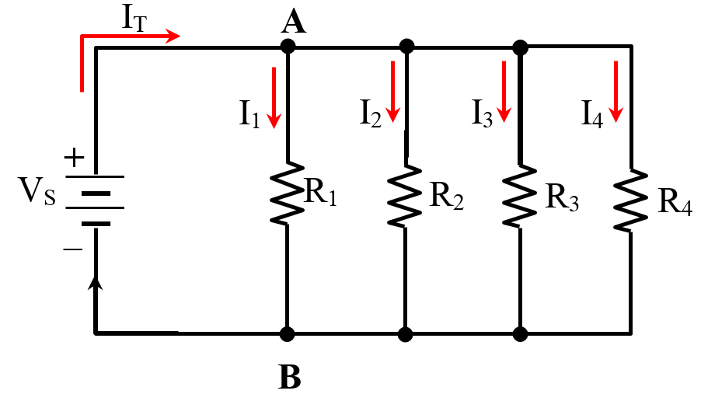
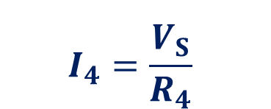
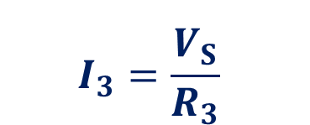
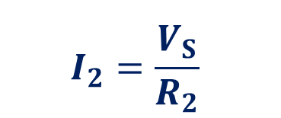

Equivalent Resistance in Parallel Connection
Apply Ohm’s law to each resistor.
$$I_{1}=\frac{V_{S}}{R_{1}}$$
$$I_{2}=\frac{V_{S}}{R_{2}}$$
$$I_{3}=\frac{V_{S}}{R_{3}}$$
$$I_{4}=\frac{V_{S}}{R_{4}}$$

Slide 11
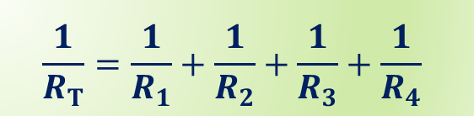

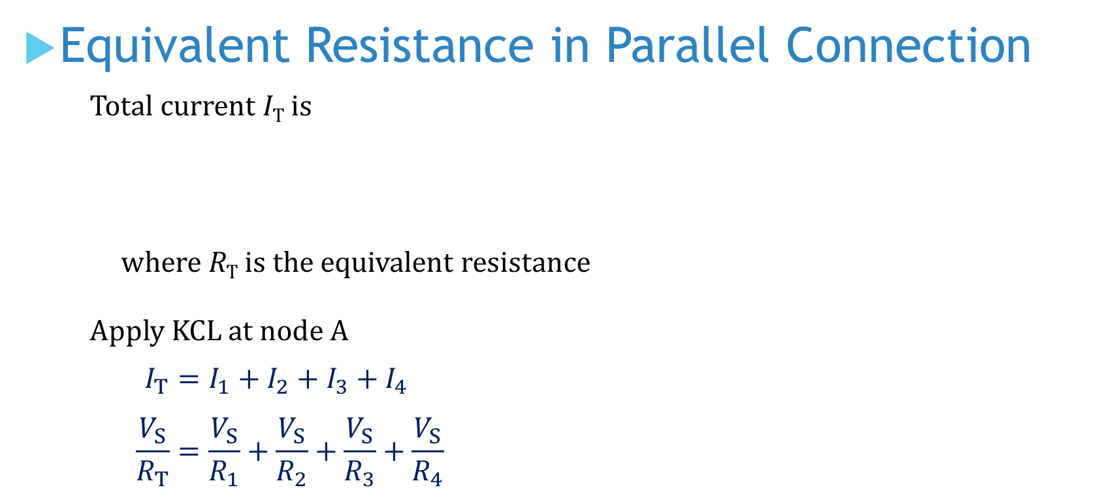
Equivalent Resistance in Parallel Connection
Total current I_{T} is
where R_{T} is the equivalent resistance
Apply KCL at node A
$$I_{T}=I_{1}+I_{2}+I_{3}+I_{4}$$
$$\frac{V_{S}}{R_{T}}=\frac{V_{S}}{R_{1}}+\frac{V_{S}}{R_{2}}+\frac{V_{S}}{R_{3}}+\frac{V_{S}}{R_{4}}$$
$$I_{T}=\frac{V_{S}}{R_{T}}$$
$$\frac{1}{R_{T}}=\frac{1}{R_{1}}+\frac{1}{R_{2}}+\frac{1}{R_{3}}+\frac{1}{R_{4}}$$

Slide 12
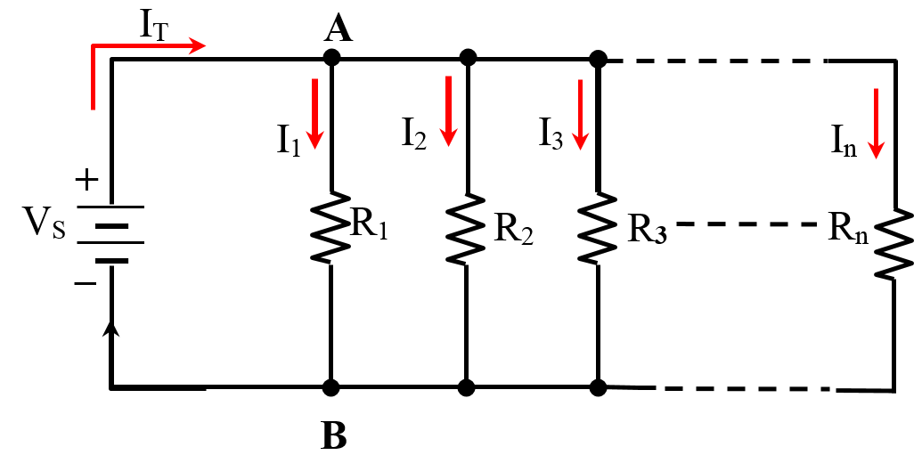
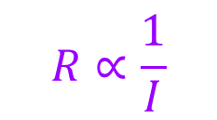
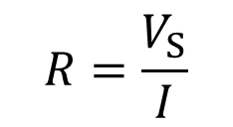
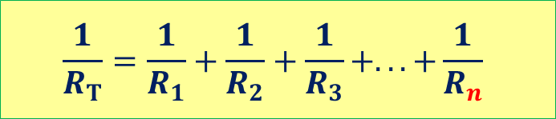
Equivalent Resistance in Parallel Connection
For n branches of parallel resistors, we have this general formula.
The reciprocal of R_{T} is the sum of all reciprocals of individual resistances.
$$\frac{1}{R_{T}}=\frac{1}{R_{1}}+\frac{1}{R_{2}}+\frac{1}{R_{3}}+...+\frac{1}{R_{n}}$$
More resistors connected in parallel, lower the total resistance.
The total resistance is always smaller than the smallest component resistance.
$$R=\frac{V_{S}}{I}$$
$$R∝\frac{1}{I}$$

Slide 13

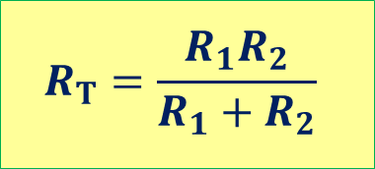

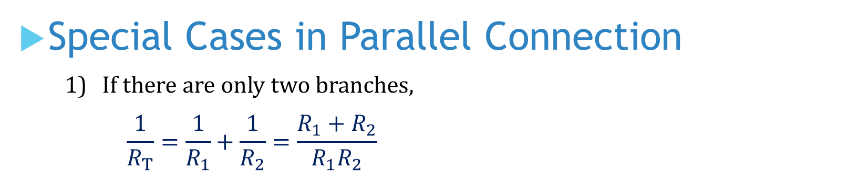
Special Cases in Parallel Connection
If there are only two branches,
$$\frac{1}{R_{T}}=\frac{1}{R_{1}}+\frac{1}{R_{2}}=\frac{R_{1}+R_{2}}{R_{1}R_{2}}$$
$$R_{T}=\frac{R_{1}R_{2}}{R_{1}+R_{2}}$$
If all n resistors are of the same value R, then the equivalent resistance is
When 2 resistors of the same resistance are connected in parallel,
$$R_{T}=\frac{R}{2}$$
$$R_{T}=\frac{R}{n}$$

Slide 14

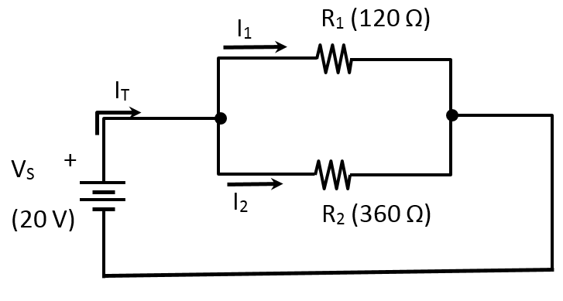

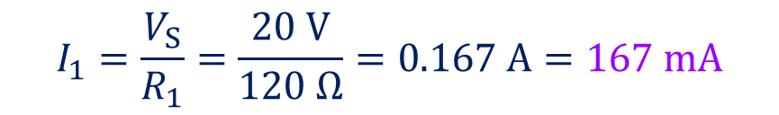

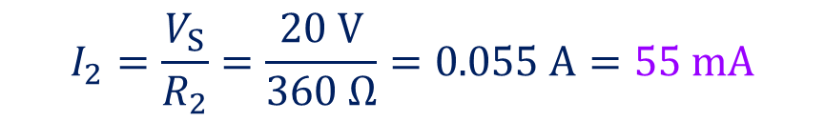
Example 2: Determine equivalent resistance R_{T} of the circuit. Hence, find currents I_{T}, I₁ and I₂.
$$R_{T}=\frac{R_{1}R_{2}}{R_{1}+R_{2}}=\frac{120×360}{120+360}=90 Ω$$
By Ohm’s law
$$I_{T}=\frac{V_{S}}{R_{T}}=\frac{20 V}{90 Ω}=0.222 A=222 mA$$
$$I_{1}=\frac{V_{S}}{R_{1}}=\frac{20 V}{120 Ω}=0.167 A=167 mA$$
$$I_{2}=\frac{V_{S}}{R_{2}}=\frac{20 V}{360 Ω}=0.055 A=55 mA$$
KCL holds? I_{T} = I₁ + I₂ ?

Slide 15
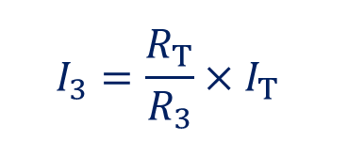
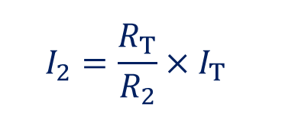

Current Divider Rule (CDR)
All branch resistances share the same voltage V_{A}.
$$I_{1}=\frac{V_{A}}{R_{1}}=\frac{I_{T}R_{T}}{R_{1}}=\frac{R_{T}}{R_{1}}×I_{T}$$
Similarly,
$$I_{2}=\frac{R_{T}}{R_{2}}×I_{T}$$
$$I_{3}=\frac{R_{T}}{R_{3}}×I_{T}$$

Slide 16
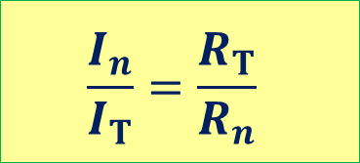
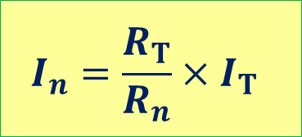
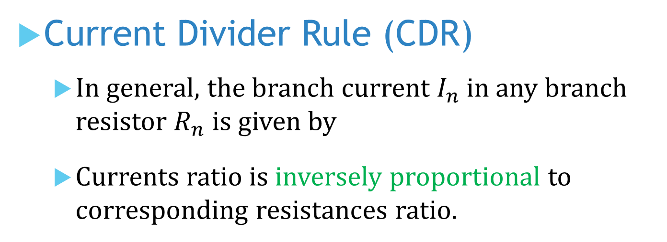
Current Divider Rule (CDR)
In general, the branch current $I_{n}$ in any branch resistor $R_{n}$ is given by
Currents ratio is inversely proportional to corresponding resistances ratio.
$$I_{n}=\frac{R_{T}}{R_{n}}×I_{T}$$
$$\frac{I_{n}}{I_{T}}=\frac{R_{T}}{R_{n}}$$
The CDR allows the determination of any branch current without knowing the voltage across the parallel connection.

Slide 17
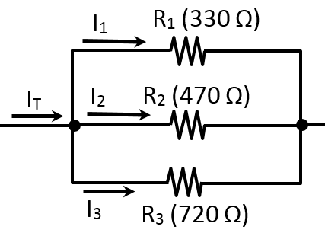
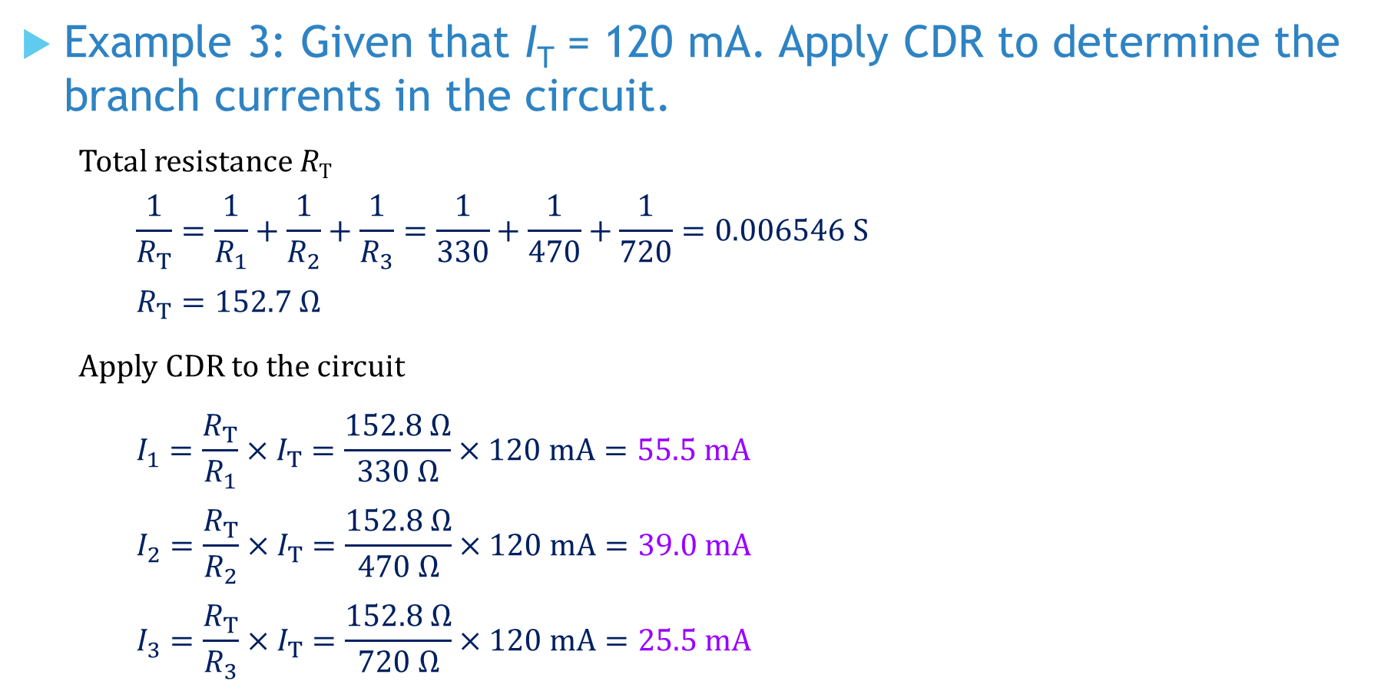
Example 3: Given that I_{T} = 120 mA. Apply CDR to determine the branch currents in the circuit.
Total resistance R_{T}
$$\frac{1}{R_{T}}=\frac{1}{R_{1}}+\frac{1}{R_{2}}+\frac{1}{R_{3}}=\frac{1}{330}+\frac{1}{470}+\frac{1}{720}=0.006546 S$$
$$R_{T}=152.7 Ω$$
Apply CDR to the circuit
$$I_{1}=\frac{R_{T}}{R_{1}}×I_{T}=\frac{152.8 Ω}{330 Ω}×120 mA=55.5 mA$$
$$I_{2}=\frac{R_{T}}{R_{2}}×I_{T}=\frac{152.8 Ω}{470 Ω}×120 mA=39.0 mA$$
$$I_{3}=\frac{R_{T}}{R_{3}}×I_{T}=\frac{152.8 Ω}{720 Ω}×120 mA=25.5 mA$$
What is the voltage across the resistors?

Slide 18


Power dissipated in a parallel circuit
The total amount of power dissipated P_{T} in a parallel circuit is the sum of all individual amount of power dissipated.
where P₁, P₂ and P₃ are individual power dissipated.
In a closed circuit, the power supply equals to total power dissipated in the circuit.
$$P_{T}=P_{1}+P_{2}+P_{3}$$
$$P_{S}=P_{T}$$

Slide 19
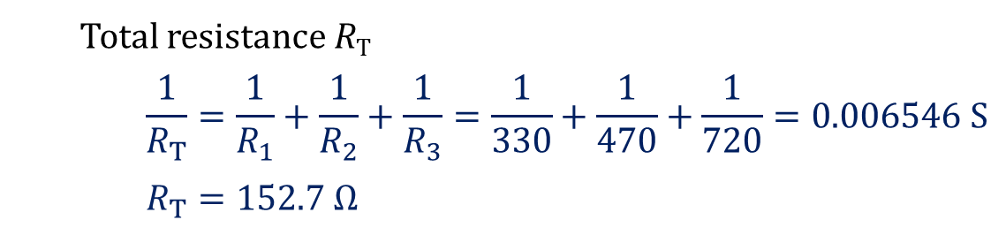
Example 4: Given that I_{T} = 120 mA. Determine the total power dissipated in the circuit.
Total resistance R_{T}
$$\frac{1}{R_{T}}=\frac{1}{R_{1}}+\frac{1}{R_{2}}+\frac{1}{R_{3}}=\frac{1}{330}+\frac{1}{470}+\frac{1}{720}=0.006546 S$$
$$R_{T}=152.7 Ω$$
$$P_{T}=I_{T}^{2}×R_{T}={\left(120×{10}^{−3}\right)}^{2}×152.7=2.2 W$$

Slide 20
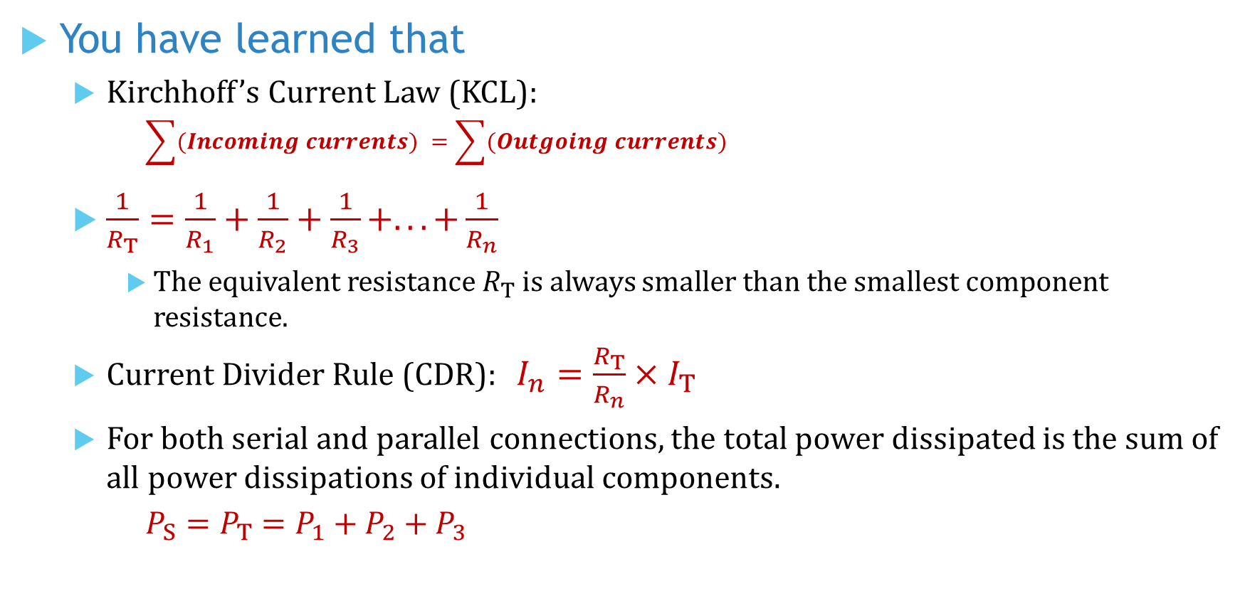
You have learned that
Kirchhoff’s Current Law (KCL):
$$\sum{(Incoming currents)} =\sum{(Outgoing currents)}$$
$\frac{1}{R_{T}}=\frac{1}{R_{1}}+\frac{1}{R_{2}}+\frac{1}{R_{3}}+...+\frac{1}{R_{n}}$
The equivalent resistance $R_{T}$ is always smaller than the smallest component resistance.
Current Divider Rule (CDR): $I_{n}=\frac{R_{T}}{R_{n}}×I_{T}$
For both serial and parallel connections, the total power dissipated is the sum of all power dissipations of individual components.
$$P_{S}=P_{T}=P_{1}+P_{2}+P_{3}$$

Slide 21
Coming Up Next
Analysis of Parallel Circuits

